Slide 1
CSIT6910D
Independent Project
4th Meeting
ZHANG Zhengyao

Slide 2
Agenda
Project Background
Project Description & Motivation
Methodologies / Implementations
User Friendly Interface - Voice Input/Output
Task Distribution - Logic Routing
Agent – Data Management & RAG
Experiment & Evaluation
Experiment Setup
Evaluation results & Case study

Slide 3



Project Description
MSc IP Collaborating with AOVA
Engineering Oriented Project
Personal Planning Agent
User Schedule Management
User Memo Management
Techinique Stack
Integration with LLM (Python, Langchain)
Data Storage Management (MySQL/Chroma)
Retrieval Augmented Generation (RAG)

Slide 4



Project Motivation
Self-learning Perspective
Obtain experience with LLM based application
Obtain deeper understanding of Agent
Industrial Perspective
Planning Assistantship is one fundamental requirement of an advanced general AI Agent

Slide 5
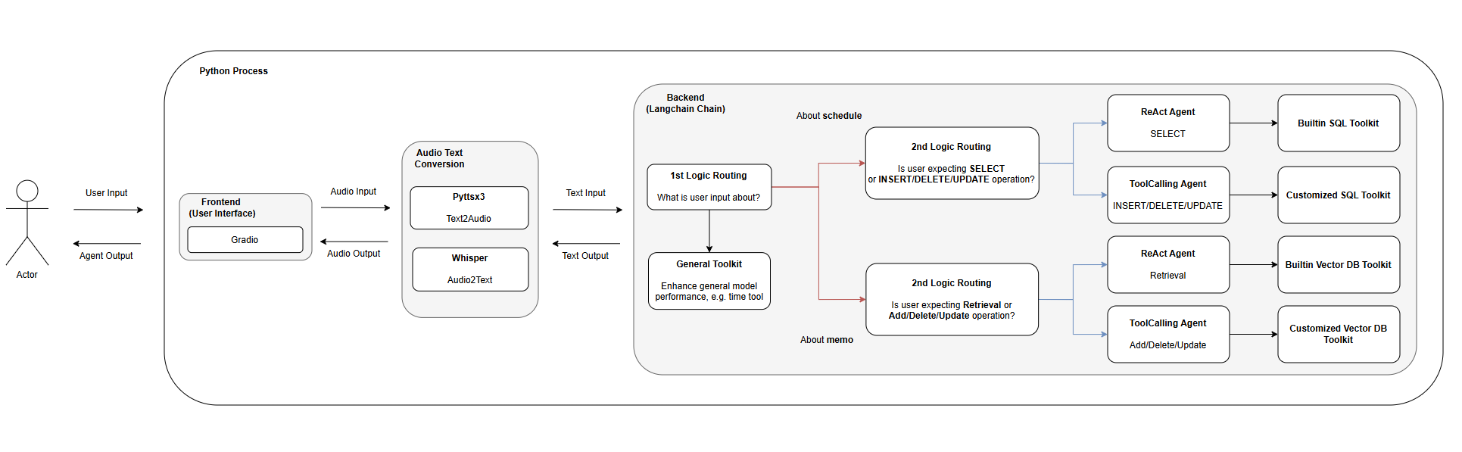
Project Architecture

Slide 6
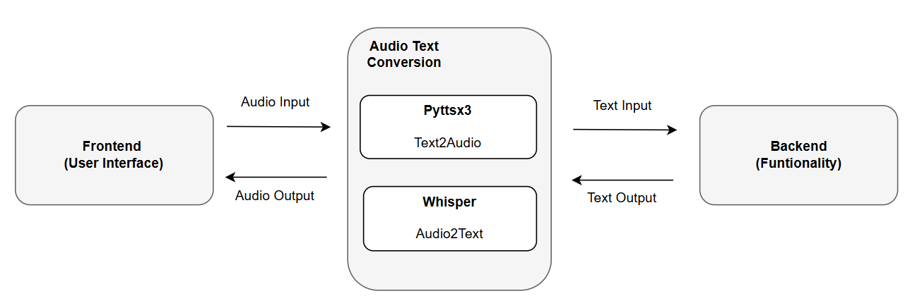
Audio Text Conversion
Audio2Text: Rely on OpenAI Whisper Model (base)
Text2Audio: Rely on OS native TTS engine (Windows)

Slide 7
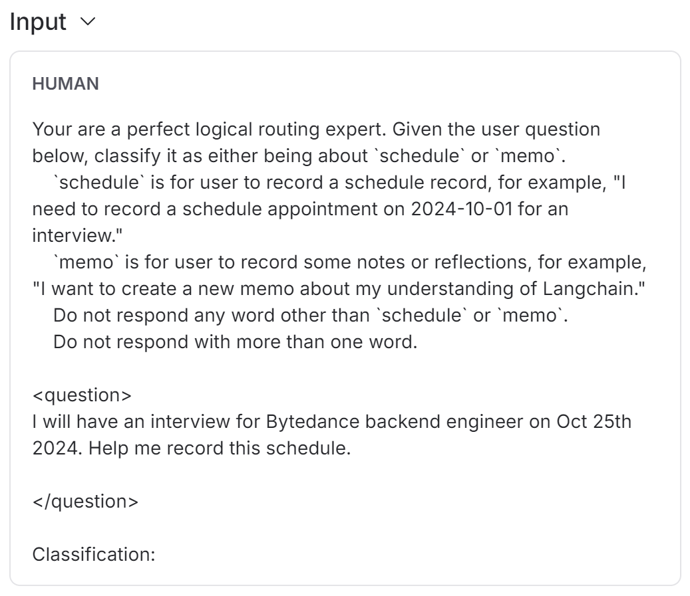
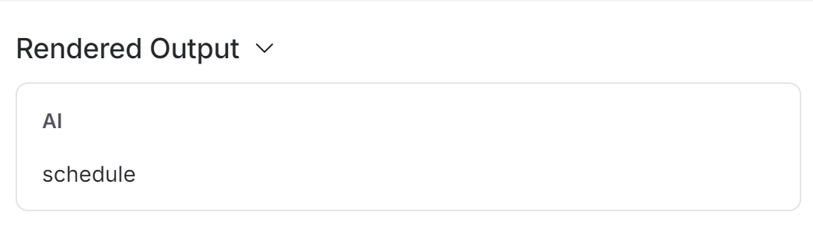
Logic Routing
One of the key functionality of Agent
Task recognition & dispatch capability reflects Agent “Intelligence”
Analogy: Human recognition of conversion context

Slide 8
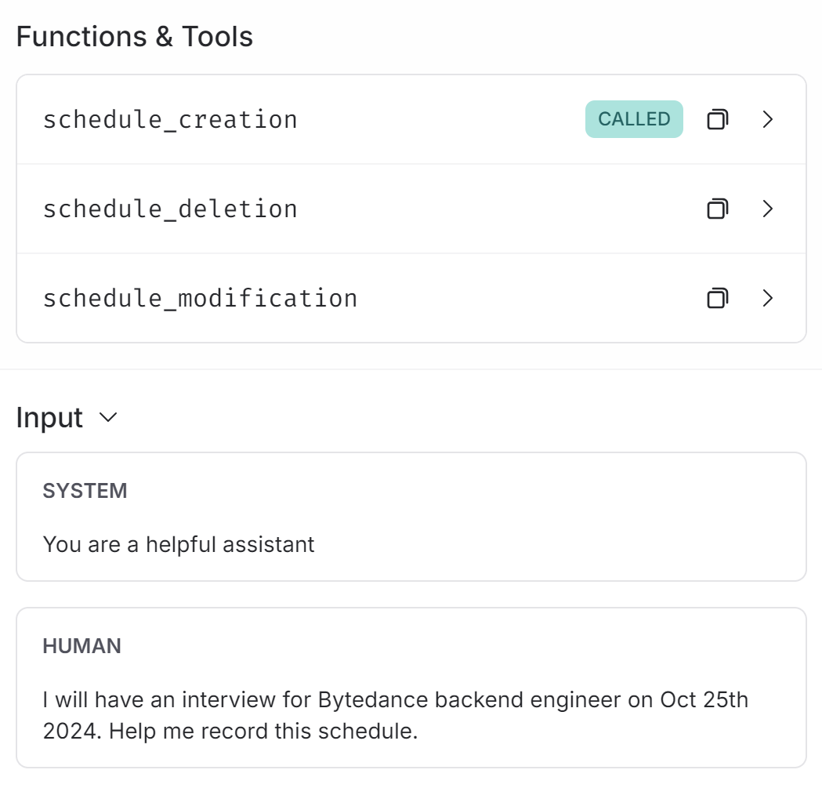
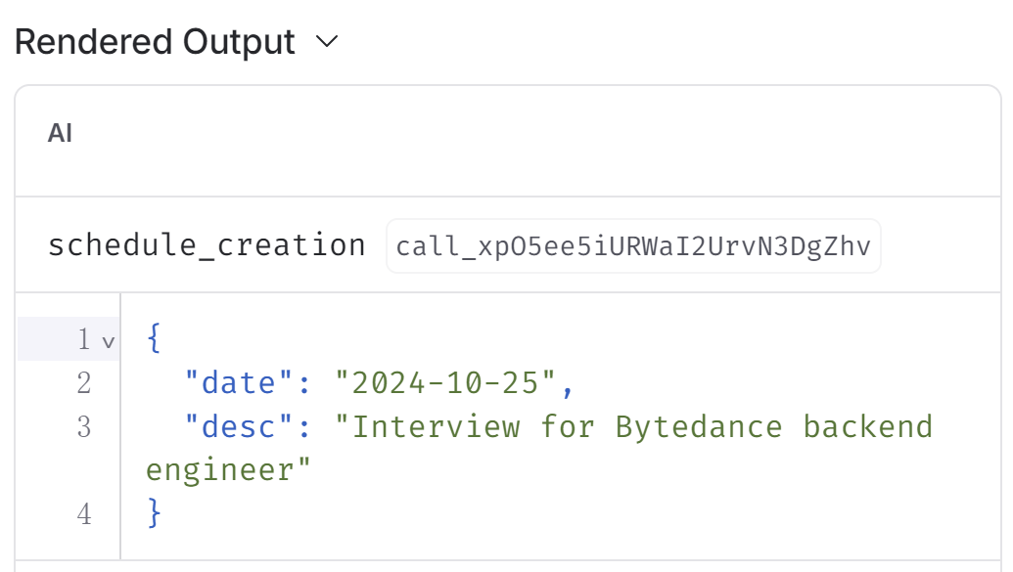
Agent Data Management
Rely on predefined function logic, & LLM capability of Tool Calling
Data security concerns → Minimum access permission
ToolCalling Agent: LLM aware of function signature & definition

Slide 9
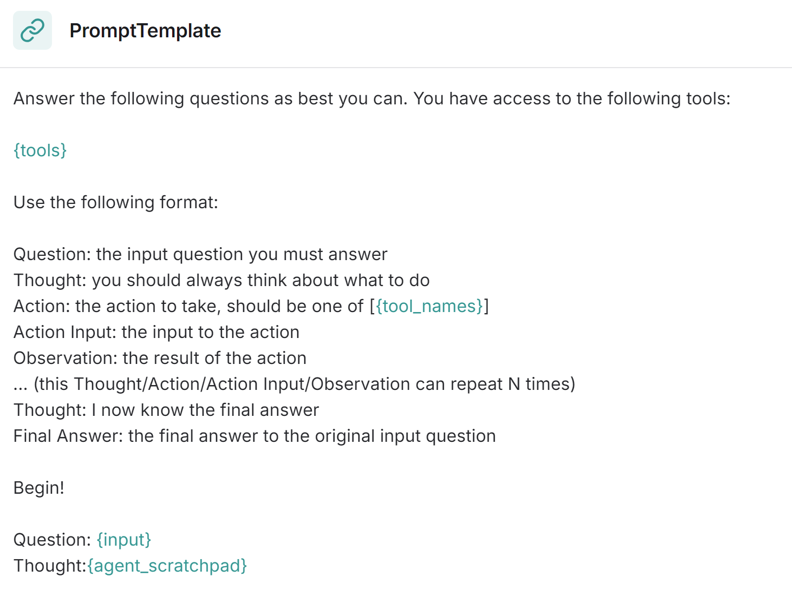
Agent Data Retrieval
Rely on built-in function logic, & LLM capability of Tool Calling
Read Only Operation → grant necessary access permission
ReAct Agent: Encourage LLM to think, act & reflect multiple times

Slide 10
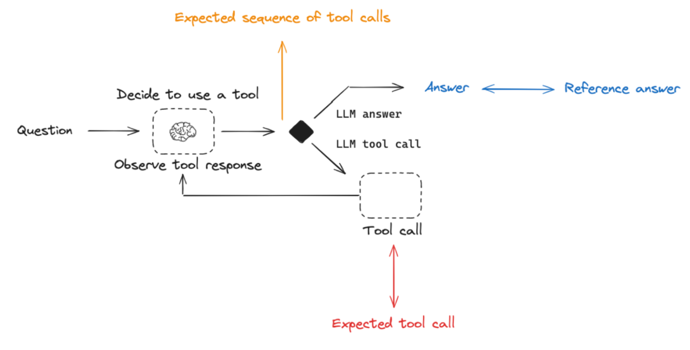
Experiment & Evaluation
Question <> Answer
Tool Decision
Trajectory
……

Slide 11
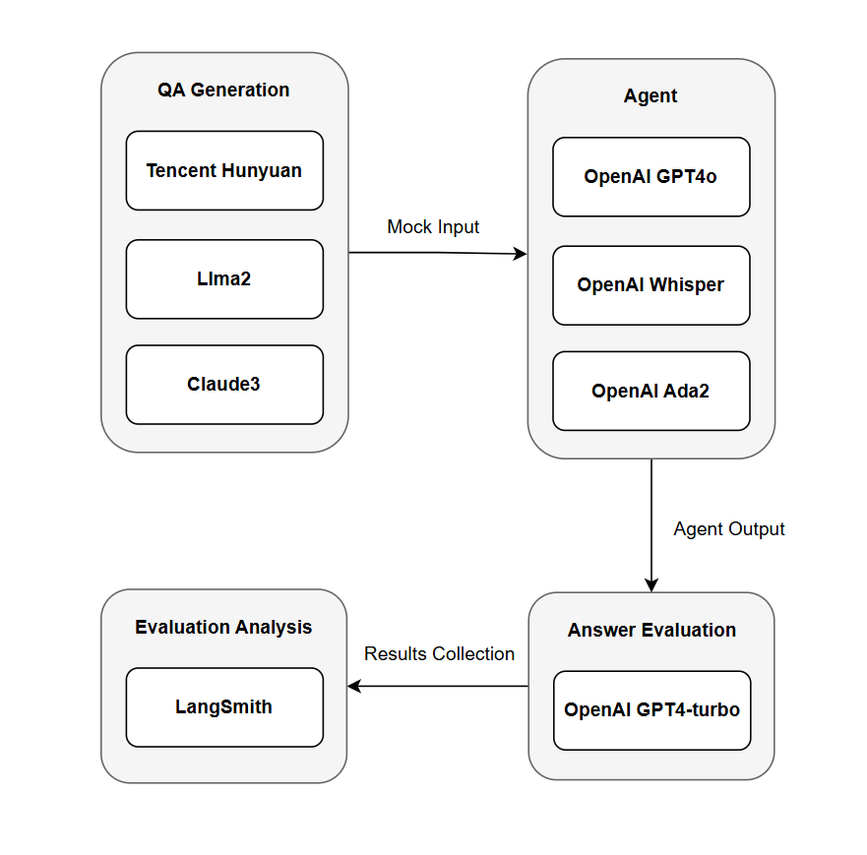
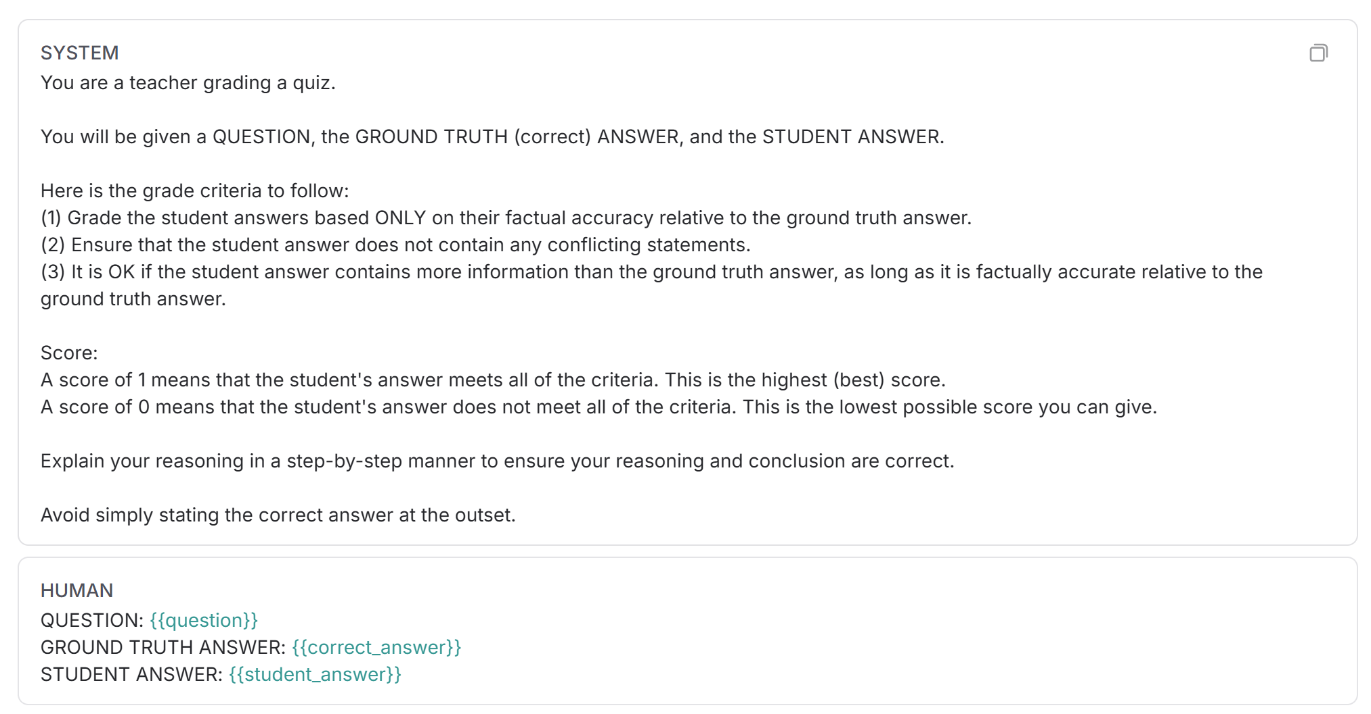

Experiment Setup

Slide 12
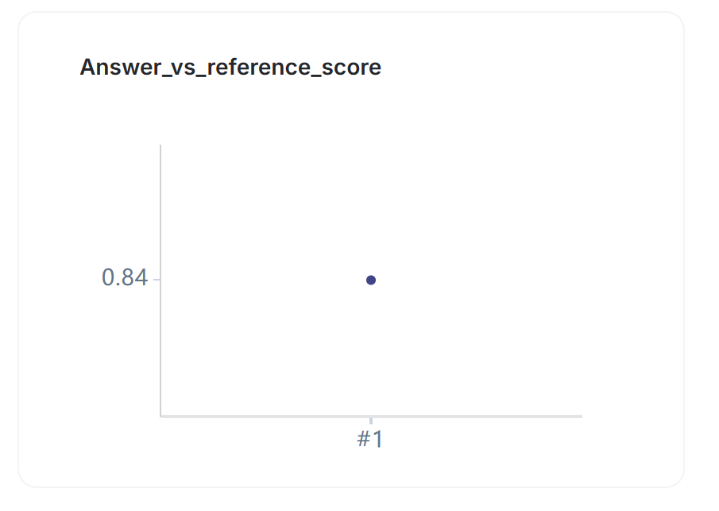
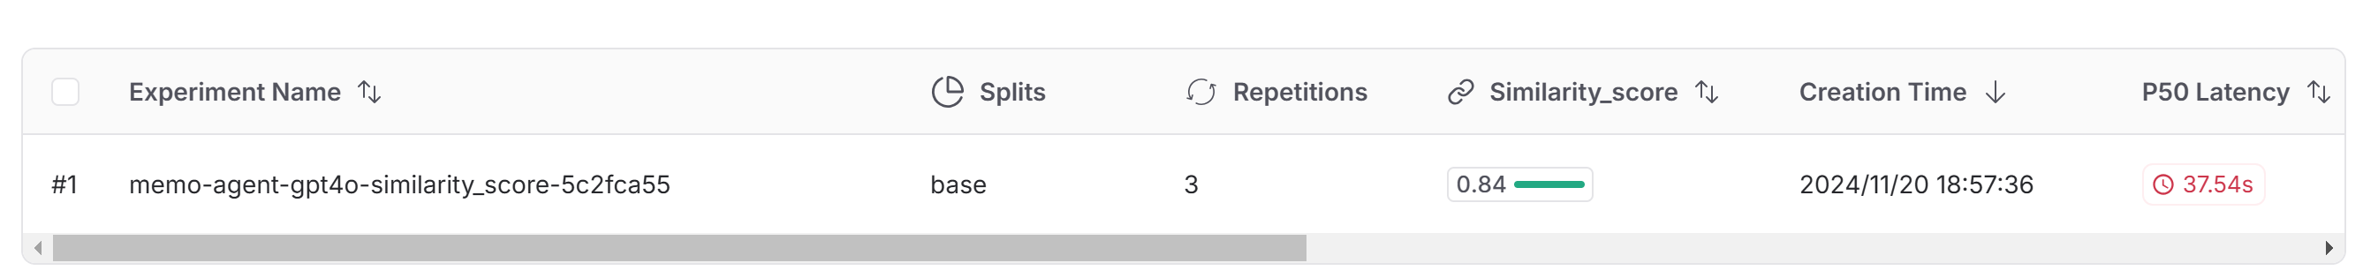
Evaluation Results
100 QA pairs (50 schedule retrieval + 50 memo retrieval)
3 evaluators each QA pair (0~1)
Avg Eval Score: 0.84
Latency: 37.54s (P50), 46.78s (P99)

Slide 13
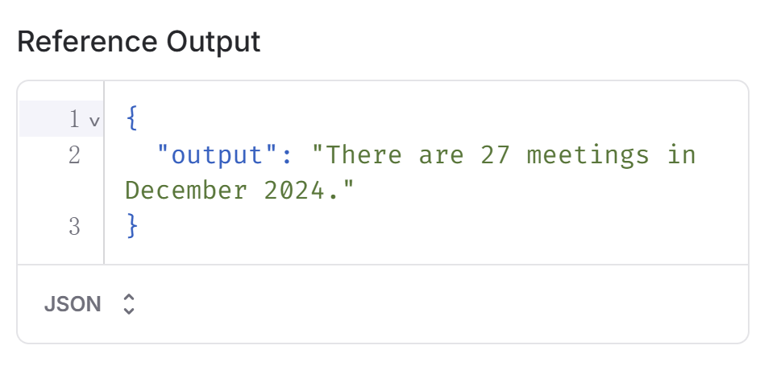
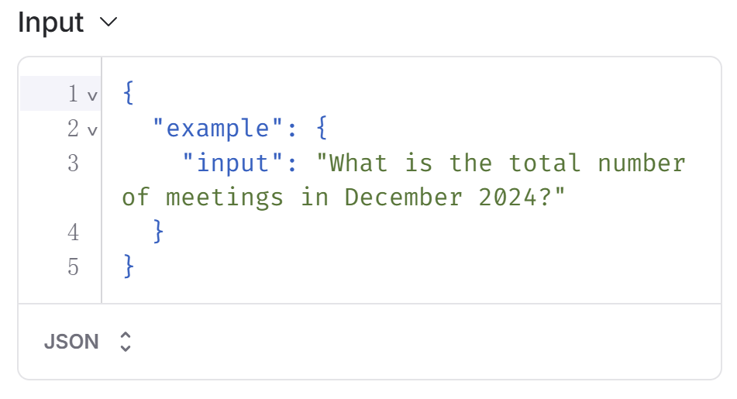
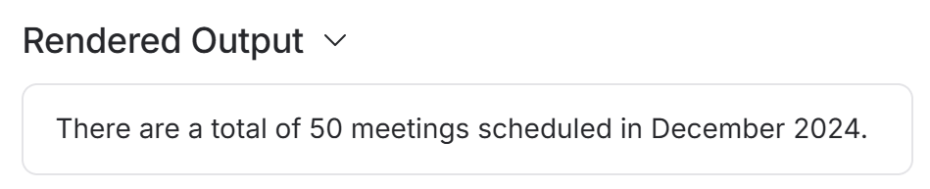
Case Study – RAG Issue
Question requires MySQL RAG, and summarization of “meeting” related schedule
Agent incorrectly outputs number of all schedules

Slide 14
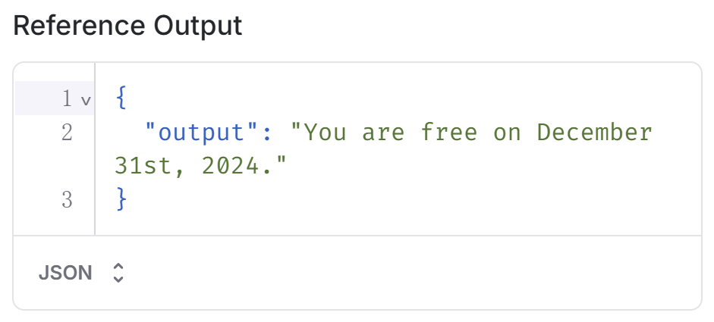
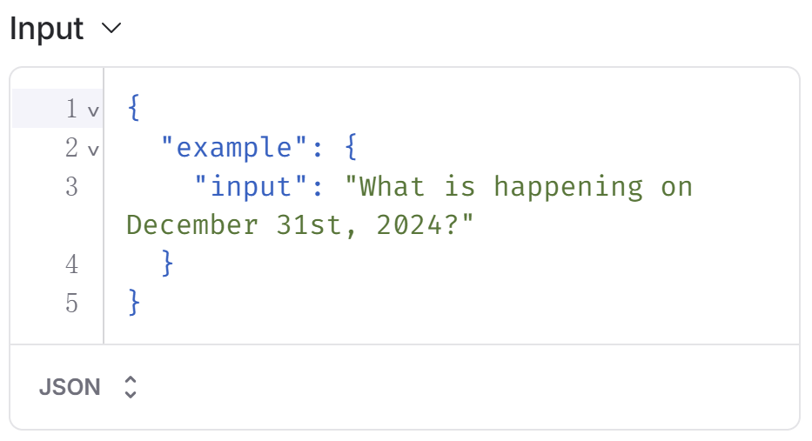
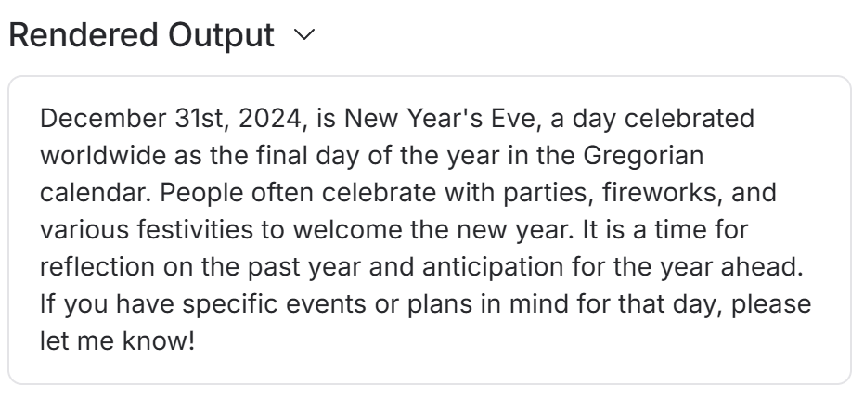
Case Study – Routing Issue
Question requires MySQL RAG
Agent incorrectly routes to Vector Storage RAG, obtains zero knowledge, outputs some very general context related to question

Slide 15
Reflection & Conclusion
Agent Routing Correctness
Prompt refinement & improvement
Integration of LangGraph
Agent RAG Performance
Agent action refinement & improvement
RAG optimization – Preprocess of user prompt / …

Slide 16
Thank You

